Slide 1
Explainable Artificial Intelligence (XAI)
Dr. Sifat Momen

Slide 2
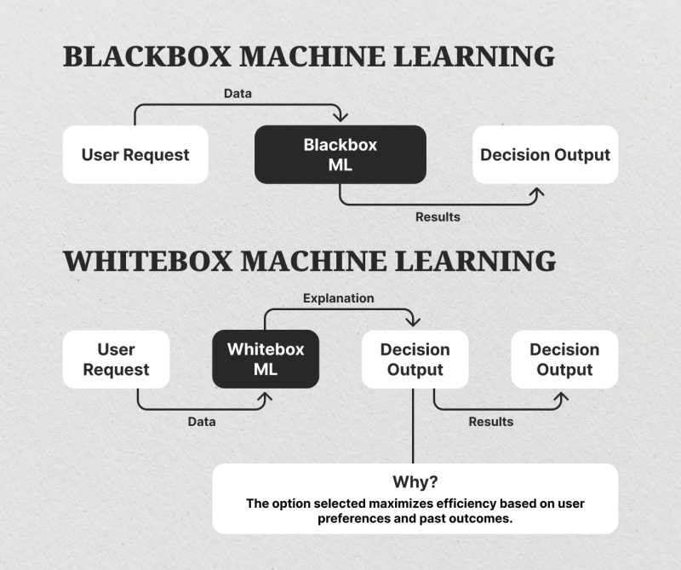
Blackbox versus Whitebox Machine Learning

Slide 3
Explainability in AI
<<To describe the purpose, rationale, and decision-making process of the AI tool in a way that can be understood by the average person>>
Data Scientist
Domain Expert (medical doctor for instance)
User/customer
Regulator/lawyer/ …

Slide 4
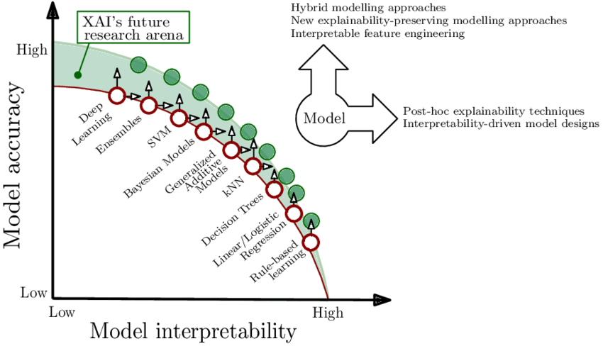
Performance and interpretability tradeoff

Slide 5
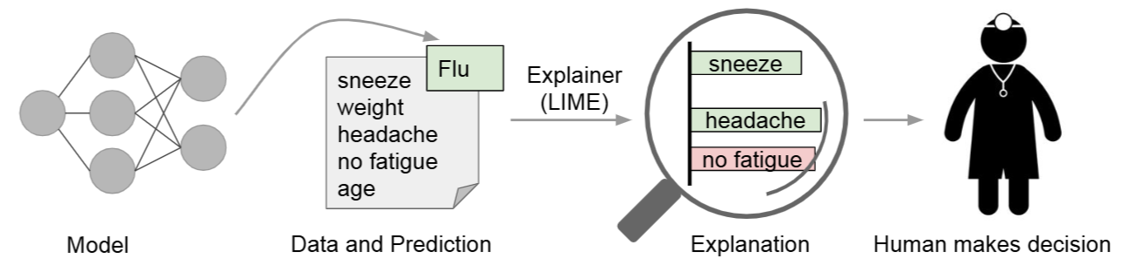
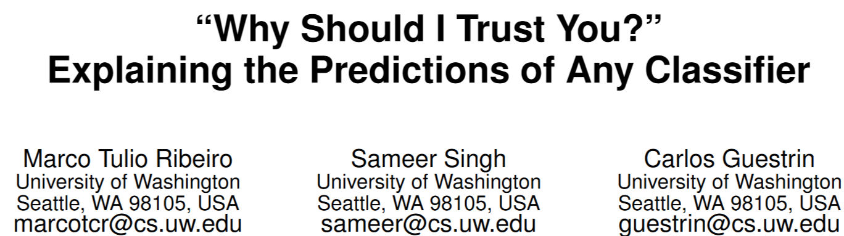
Local Interpretable Model-Agnostic Explanations (LIME)
Instance Specific Explanations

Slide 6
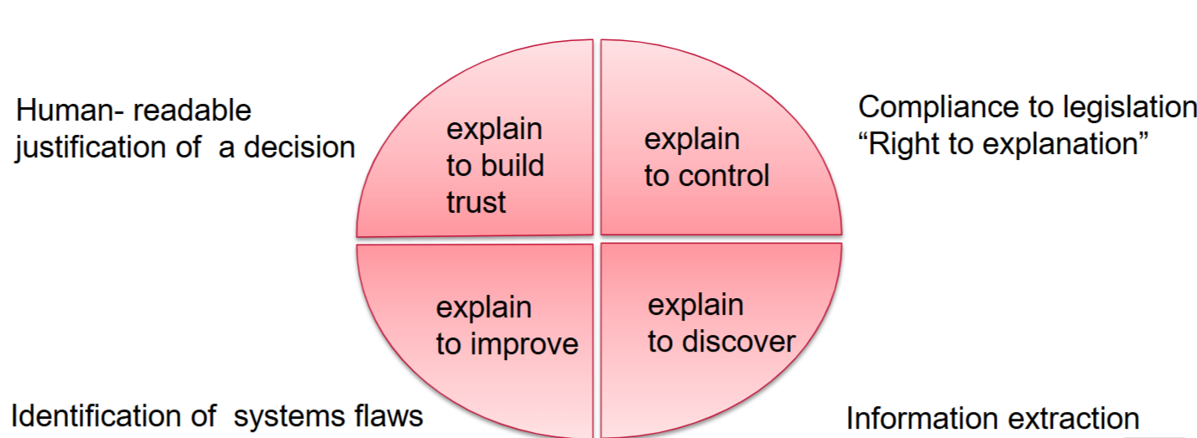
The need for Explainability

Slide 7

The need for Explainability
A challenging example cited by Kaufman et al. is one where the patient ID was found to be heavily correlated with the target class in the training and validation data. This issue would be incredibly challenging to identify just by observing the predictions and the raw data, but much easier if explanations could have been provided.

Slide 8
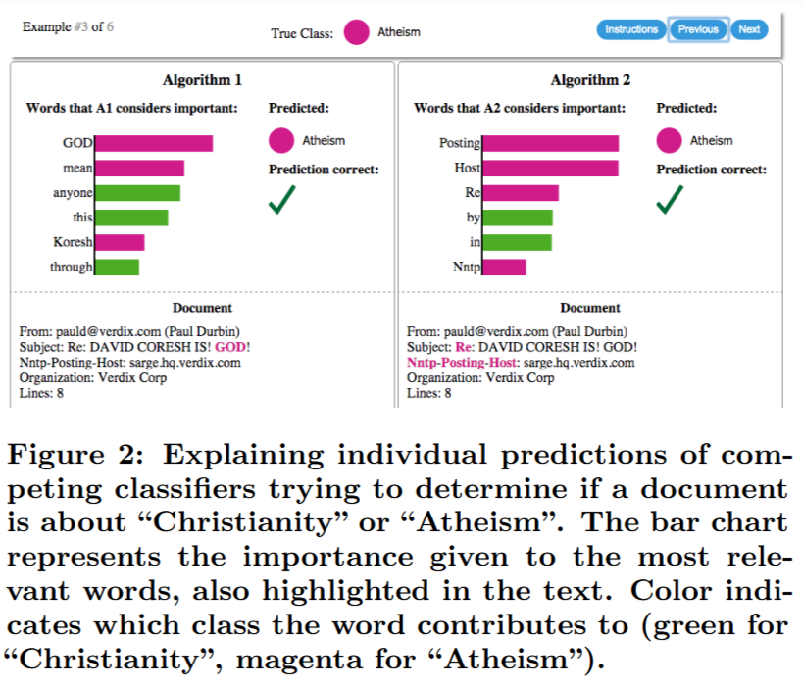
The need for Explainability
Explainability can be very useful for model selection as well. The algorithm with higher accuracy on the validation set is actually much worse, a fact that is easy to see when explanations are provided (again, due to human prior knowledge), but hard otherwise.

Slide 9
Desired Characteristics for Explainers
An essential criterion for explanations is that they must be interpretable, i.e., provide qualitative understanding between the input variables and the response.
For example, if hundreds or thousands of features significantly contribute to a prediction, it is not reasonable to expect any user to comprehend why the prediction was made, even if individual weights can be inspected.
This requirement further implies that explanations should be easy to understand.
Finally, note that the notion of interpretability also depends on the target audience.

Slide 10
Desired Characteristics for Explainers
Another essential criterion is local fidelity.
Although it is often impossible for an explanation to be completely faithful unless it is the complete description of the model itself, for an explanation to be meaningful it must at least be locally faithful, i.e. it must correspond to how the model behaves in the vicinity of the instance being predicted.
Please note that local fidelity does not imply global fidelity: features that are globally important may not be important in the local context, and vice versa.

Slide 11
Desired Characteristics for Explainers
While there are models that are inherently interpretable, an explainer should be able to explain any model, and thus be model-agnostic (i.e. treat the original model as a black box).

Slide 12
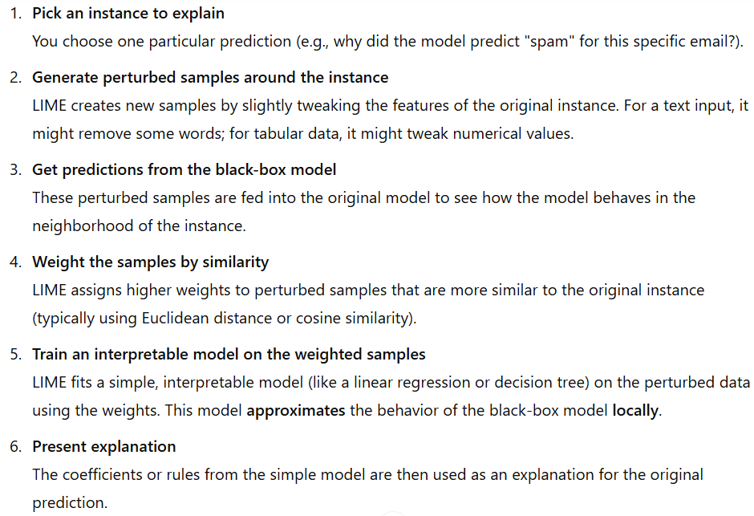
How LIME Works

Slide 13

Example 1

Slide 14
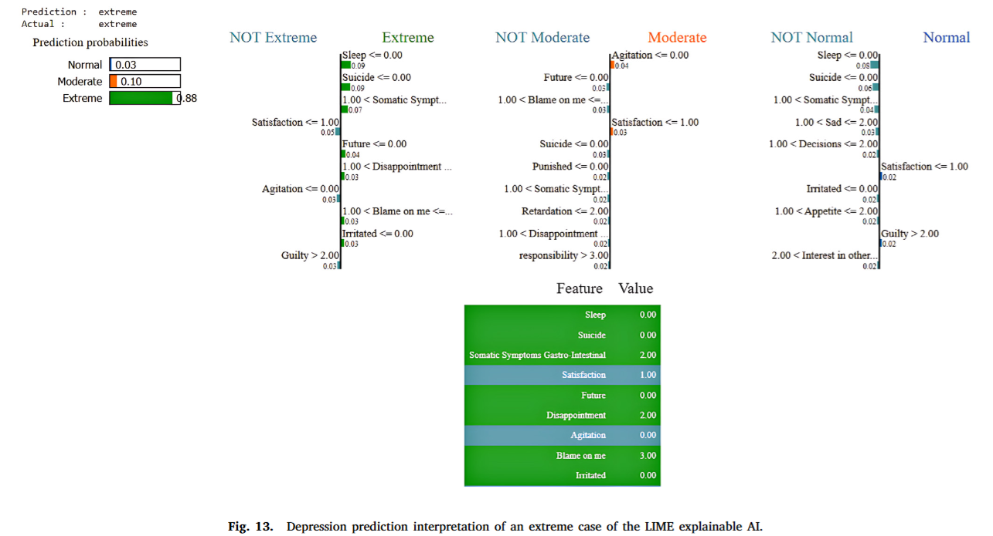
Example 1

Slide 15
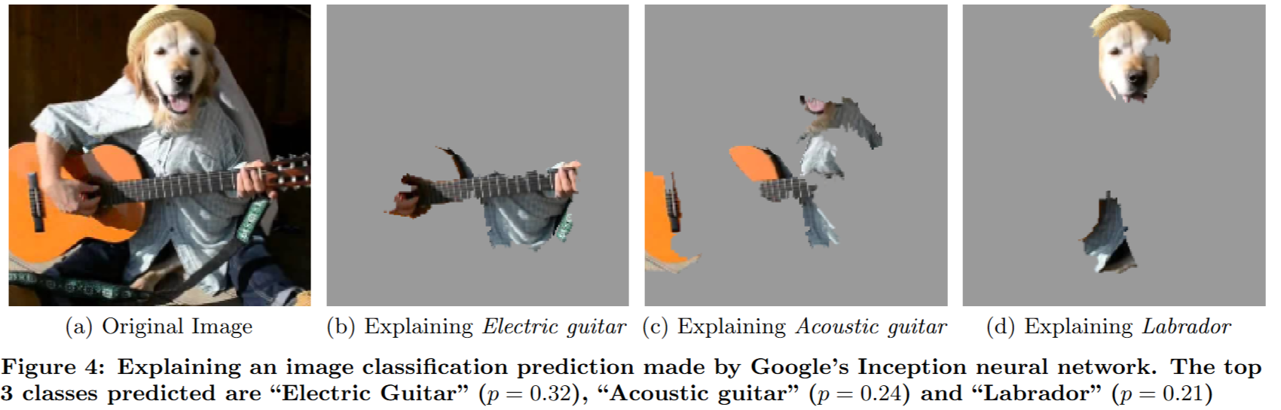
Example 2

Slide 16
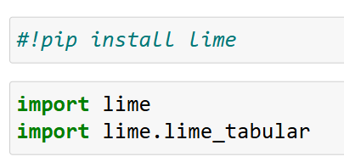
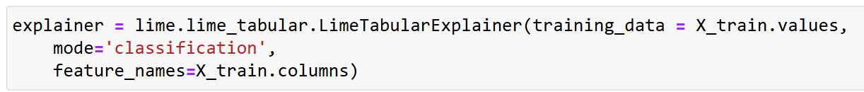
LIME Code

Slide 17
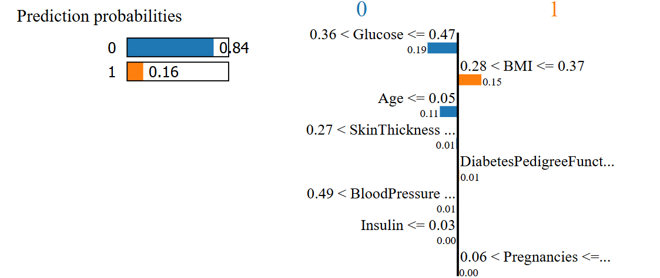
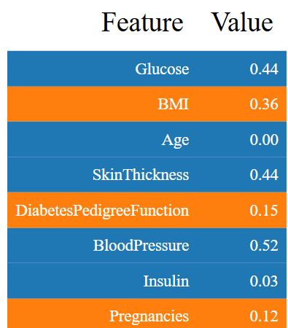
LIME Code

